Slide 1
POINT IN TIME COUNT UNSHELTERED SURVEY

Slide 2
2022 Unsheltered Count Survey
The 2022 Unsheltered PIT Count Survey is designed to collected the HUD required data elements
Each LHC must collect, at a minimum, the data requested in the survey
All persons facilitating the survey should be trained ahead of time
The survey is only intended for those in unsheltered settings, not those in Emergency Shelter, Transitional Housing or Domestic Violence programs

Slide 3
2022 Unsheltered Count Survey
The 2022 PIT Survey is available in a digital and paper format
LHCs will decide which format to use, however the digital version is encouraged to streamline data collection
The digital version will be available via Google Forms and can be accessed via computer, smart phone or tablet
Regardless of the version used, all Unsheltered Survey data must be entered into the Google Form by February 4, 2022

Slide 4
2022 Unsheltered Count Survey
Unsheltered PIT Timeline
The Unsheltered PIT Count is Wednesday, January 26th, 2022
The last day to conduct surveys for those who slept in unsheltered settings on January 26th is February 2rd, 2022
All unsheltered survey data must be entered into Google Form digital version of the survey by February 4th, 2022
LHCs can keep their paper surveys, no need to submit to the Lead Agency once all data is entered

Slide 5
2022 Unsheltered Survey Review
Survey Review
The online and paper survey can be accessed HERE
Additional PIT resources and training materials accessed HERE
The following slides include screenshots of the Unsheltered Survey and a brief explanation

Slide 6
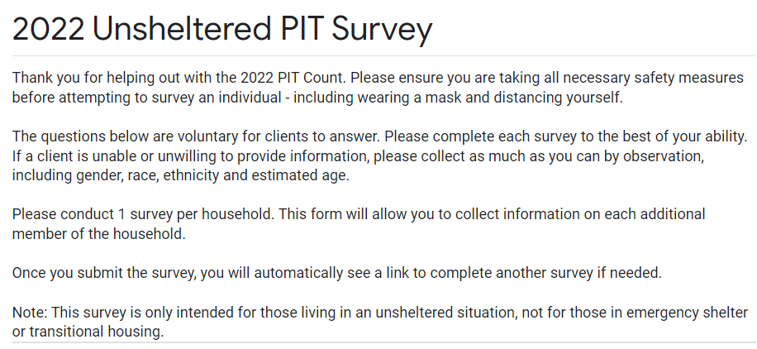
2022 Unsheltered Survey Review
Survey Introduction
All survey questions are voluntary for clients
Complete 1 survey per Household
This survey is ONLY for those living in unsheltered situations – NOT Emergency Shelter or Transitional Housing Projects

Slide 7
2022 Unsheltered Survey Review
Surveyor Information
Requested in case there is need for clarification after the count

Slide 8
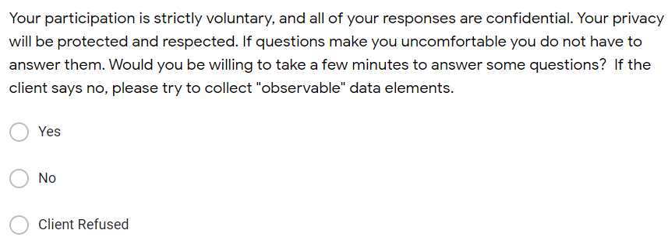
2022 Unsheltered Survey Review
Prior Survey
Asked to prevent duplicate survey information
Consent
Asked to allow client to give consent to data collection and ensure that all responses are confidential

Slide 9
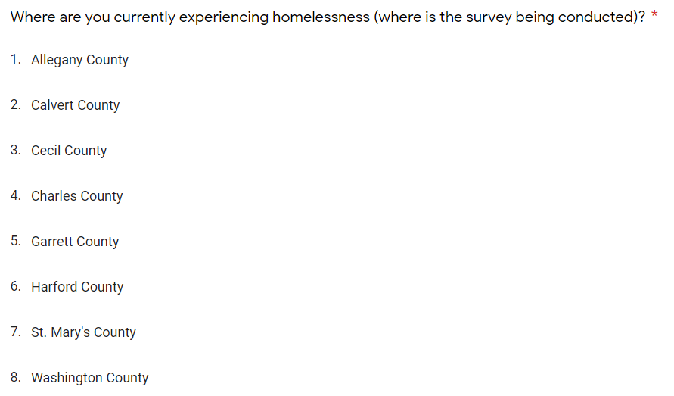
2022 Unsheltered Survey Review
Location
Select the county where the client is experiencing homelessness, should be the same as where the survey is being taken.

Slide 10
2022 Unsheltered Survey Review
Unsheltered Verification
Asked to ensure that the client was sleeping in an unsheltered location on the night of January 26, 2022 and eligible to complete the survey. If the individual was NOT sleeping in an unsheltered location on the 26th, you may end the survey at this time.
Notes:
Explain what each is

Slide 11
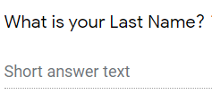
2022 Unsheltered Survey Review
Client Name & SSN
Name / Street Name / Nickname asked to ensure client is not counted more than once
Last four digits of Social Security number strictly used for de-duplication purposes
Client can provide whatever information they are comfortable with

Slide 12
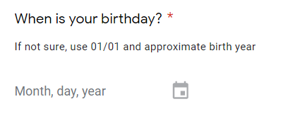
2022 Unsheltered Survey Review
Birthday
Enter the client date of birth if provided
Enter the client age or best estimate if not provided

Slide 13
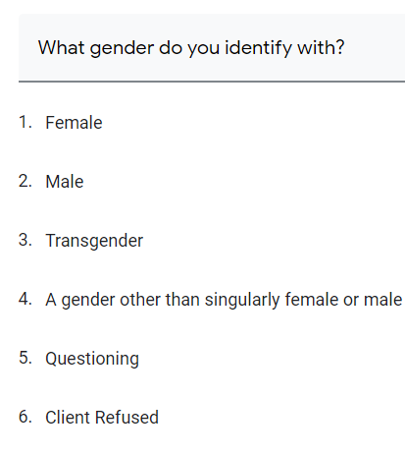
2022 Unsheltered Survey Review
Gender Identity
Ask the client what gender they identify with
Responses are updated with HUD requirements

Slide 14
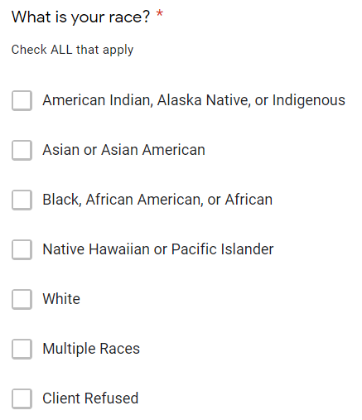
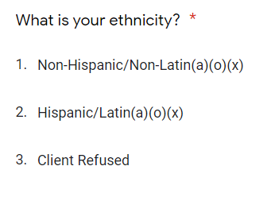
2022 Unsheltered Survey Review
Race & Ethnicity:
Select ALL race options that apply
Select only one ethnicity option

Slide 15
2022 Unsheltered Survey Review
Observation Survey Elements
If the client is unwilling or unable to provide survey responses, please collect as much “observable” information as possible, including
Survey Location
Estimated Age
Gender
Race

Slide 16
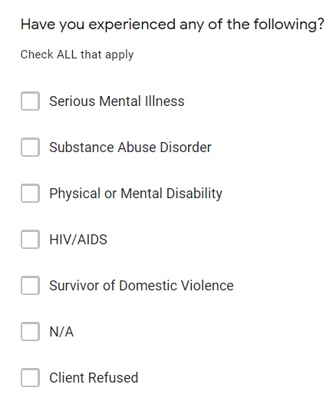
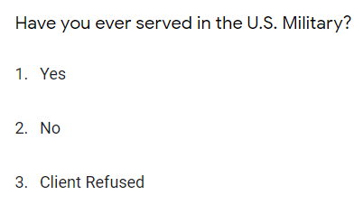
2022 Unsheltered Survey Review
Additional Information
Please ask is the individual has experienced any of the listed conditions
Please ask if the individual has served in the US Military and is a Veteran

Slide 17
2022 Unsheltered Survey Review
Length of Time Homeless:
Questions are intended to identify if client is experiencing Chronic Homelessness
Asked to identify how long the person has been homeless
Asked to identify how many times the person has been homeless

Slide 18
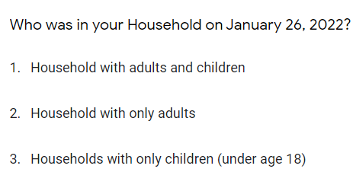
2022 Unsheltered Survey Review
Household Composition on January 26, 2022
Please select the appropriate household type
Household with adults and children: should include at least one adult, 18 years or older and one child, 17 years or younger. Example: Single parent with child
Household with only adults: no member under the age of 18 in the household. Example: Single adult, adult couple
Household with only children: no one over the age of 18 years in the household. Example: Unaccompanied child(ren) with no adult present

Slide 19
2022 Unsheltered Survey Review
Additional Household Members
If there are no additional household members present on January 26th, you may end the survey here
If there are additional members present, the survey will allow for basic information to be collected for up to 5 additional individuals

Slide 20
2022 Unsheltered Survey
Reminders:
The Unsheltered PIT Survey is intended for those sleeping in an unsheltered location on the night of January 26th, 2022
Please complete one survey per household
Last day to collect survey data on those who slept in unsheltered location on 1/26 is February 2nd, 2022
All survey data MUST be entered into the Google Form Digital survey by February 4th, 2022
Data for those sleeping in Emergency Shelter or Transitional Housing on 1/26/22 will be collected from HMIS
Notes:
Explain what each is

Slide 21
Thank You!

